Slide 1
recommender systems based on collaborative filtering
Faeze Saeedi Nejad | Spring 2021

Slide 2
Topics
Concepts
Understanding you
Top-N recommender
Installations
SurpriseLib
Evaluation
Errors
Metrics
Recommender engine
AlgoBase
Similarity metrics
User-based collaborative filtering
Item-based collaborative filtering
Conclusion
References

Slide 3
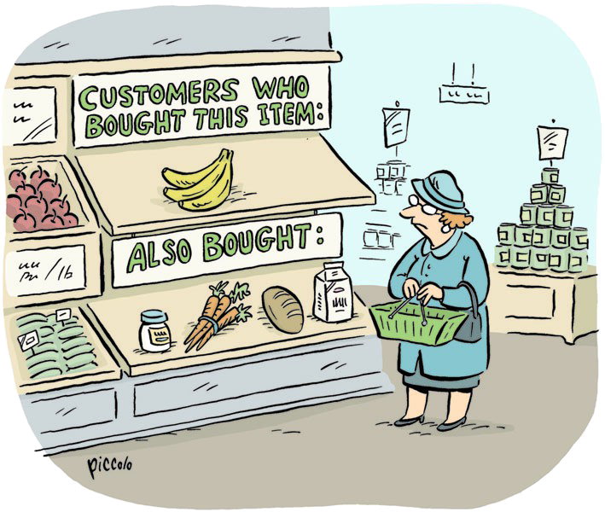
Concepts
Recommender systems make it easy for user to find what they want using their pervious information.
Before recommending, recommender system should understand users and their interests to use that data for recommendations.

Slide 4
Concepts
Understanding you explicitly
Sparsity
Different standards

Slide 5
Concepts
Understanding you implicitly
Like: lots of Amazon purchase data
Explicit movie ratings using MovieLens data
things you click on
things you
purchase
things you
consume

Slide 6
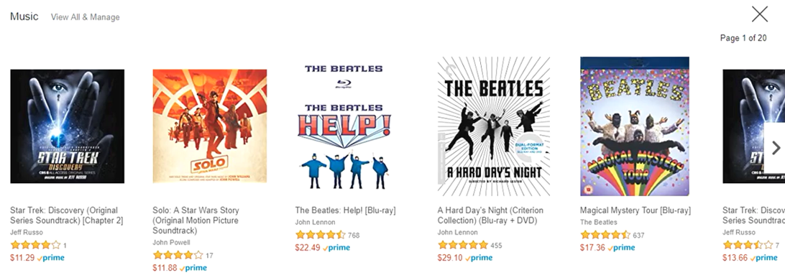
Concepts
Top-N recommender

Slide 7
Concepts
How it works?
individual interests
candidate generation
item similarities
candidate ranking
filtering

Slide 8
Topics
Concepts
Understanding you
Top-N recommender
Installations
SurpriseLib
Evaluation
Errors
Metrics
Recommender engine
AlgoBase
Similarity metrics
User-based collaborative filtering
Item-based collaborative filtering
Conclusion
References

Slide 9
Installation
SurpriseLib

Slide 10
Topics
Concepts
Understanding you
Top-N recommender
Installations
SurpriseLib
Evaluation
Errors
Metrics
Recommender engine
AlgoBase
Similarity metrics
User-based collaborative filtering
Item-based collaborative filtering
Conclusion
References

Slide 11
Evaluation
A big part of why recommender systems are as much art as they are science is that it’s difficult to measure how good they are!

Slide 12
Evaluation
Methodology for testing offline
full data set (movie ratings, etc.)
training set
test set
machine
learning (RecSys)
measure
accuracy
predictions

Slide 13
Evaluation
How accurately you can predict how users rated movies they’ve already seen and provided a rating for

Slide 14
Evaluation
More ways to evaluate

Slide 15
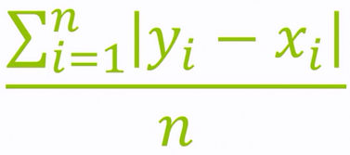
Evaluation
Mean absolute error (MAE)
predicted ratings
actual ratings
error
5
4
5
1
3
1
4
1
2
3
1
0
MAE = (2+3+1+0)/4 = 1.5

Slide 16
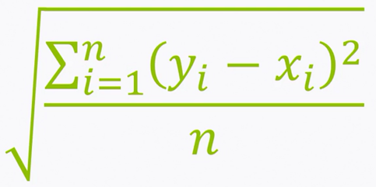
Evaluation
Root mean square error (RMSE)
More fancy way to measure accuracy
Penalization
predicted ratings
actual ratings
error²
5
4
5
1
3
1
4
1
4
9
1
0
MAE = √(4+9+1+0) /4 = 1.87

Slide 17
Evaluation
But that’s not what the user wants, they don’t care if your system is good/bad at predicting the ratings, users want to see top-N recommendations for them

Slide 18

Evaluation
Metrics that are more focused on top-N recommenders

Slide 19
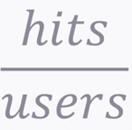
Evaluation
Hit rate
Using test set, you create top-N recommendation for each user, if they’ve already seen it and liked it, it’s considered as a hit

Slide 20
Evaluation
Accuracy isn’t the only thing that matters when it comes to evaluating recommender systems

Slide 21
Evaluation
Coverage
Bigger dataset = better coverage score
% of <user, item> pairs that can be provided

Slide 22
Evaluation
Diversity
How broad of variety items the recommender system is putting in front of people
Low diversity: recommending just the next book in Harry Potter series
(1 – S)
S = avg similarity between recommendation pairs

Slide 23
Evaluation
Novelty
Popularity rank of recommended items
But user-trust is more important, so making a trade-off between new items and familiar items to user, is important
New items -> discovering / familiar items -> user-trust

Slide 24
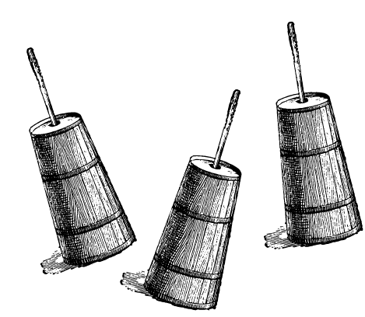
Evaluation
Churn
How often do recommendations change?
System’s sensitivity to user’s behavior

Slide 25
Evaluation
Responsiveness
How quickly does new user’s behavior influence your recommendations?
Strike a balance between simplicity and responsiveness
What’s important?

Slide 26
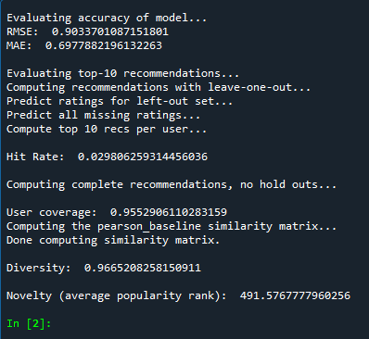
Evaluation
It takes too long to run, why? cause it needs to predict ratings
Average 0.7 error predicting rating
Diversity and novelty are high, don’t forget user-trust

Slide 27
Topics
Concepts
Understanding you
Top-N recommender
Installations
SurpriseLib
Evaluation
Errors
Metrics
Recommender engine
AlgoBase
Similarity metrics
User-based collaborative filtering
Item-based collaborative filtering
Conclusion
References

Slide 28
Recommender engine
Many ways to measure similarity score
Cosine similarity is the most popular

Slide 29

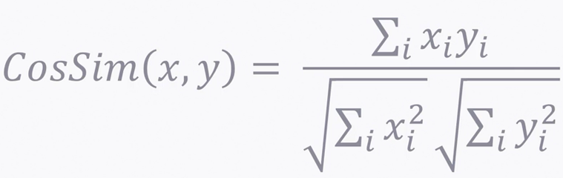

Recommender engine
Cosine similarity
45° isn’t a useful similarity metric, we want something between 0 and 1
The cosine of the angle does just that
0.7 is the cosine similarity score
Multi dimensional
adventure
comedy

Slide 30
Recommender engine
Collaborative filtering
Finding similar users/items is the challenge
individual interests
candidate generation
item similarities
candidate ranking
filtering

Slide 31




Recommender engine
User-based collaborative filtering
Finding similar users based on ratings history

Slide 32
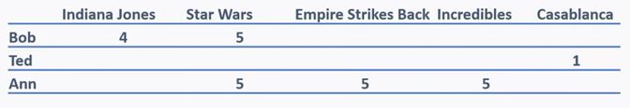
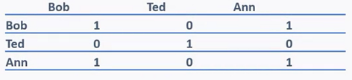
Recommender engine
Table of all the ratings from everyone in our system
2-d array and then a table for cosine similarity
Bob’s neighbors: Ann: 1.0, Ted: 0

Slide 33
Recommender engine
So we consider Ann in Bob’s top-N similar users
In a less sparse data, there would be a better top-N users other than just Ann
Recommendation candidates
1.0
1.0

Slide 34
Recommender engine
Sort the candidates then filter them
1.0
1.0

Slide 35
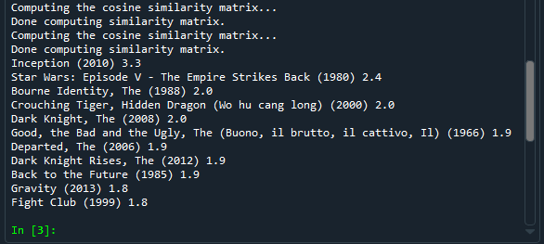
Recommender engine
Hands on
No need to split test/train set cause we’re not measuring accuracy, we’re just making top-N recommendations
It’s quick

Slide 36
Recommender engine
Item-based collaborative filtering
Things, not people cause things are more permanent nature than people

Slide 37
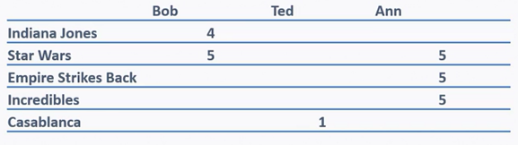
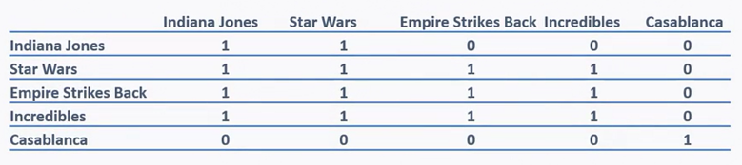
Recommender engine
Just flip the users and items
Measure similarity between items based on ratings

Slide 38
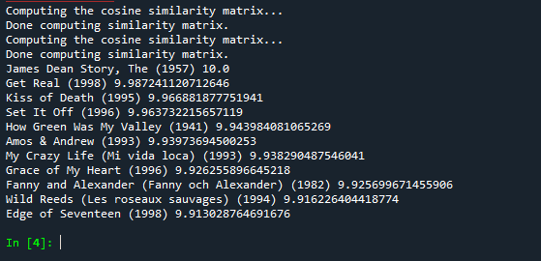
Recommender engine
Hands on
Similar cause the general approach is the same
Focus the relationship between items
Amazon uses this

Slide 39
Topics
Concepts
Understanding you
Top-N recommender
Installations
SurpriseLib
Evaluation
Errors
Metrics
Recommender engine
AlgoBase
Similarity metrics
User-based collaborative filtering
Item-based collaborative filtering
Conclusion
References

Slide 40
Conclusion
Evaluating is important
SurpriseLib made implementation easy
More data to work with = better recommender system
Github link:
https://github.com/fzsdi/collaborative-filtering

Slide 41
Topics
Concepts
Understanding you
Top-N recommender
Installations
SurpriseLib
Evaluation
Errors
Metrics
Recommender engine
AlgoBase
Similarity metrics
User-based collaborative filtering
Item-based collaborative filtering
Conclusion
References

Slide 42
References
Building Recommender Systems with Machine Learning and AI (Frank Kane)
Build a Recommendation Engine With Collaborative Filtering (Abhinav Ajitsaria)
How to Build Simple Recommender Systems in Python (Bryan Tan)
Other references are in the thesis file

Slide 43
Thank you

